Slide 1

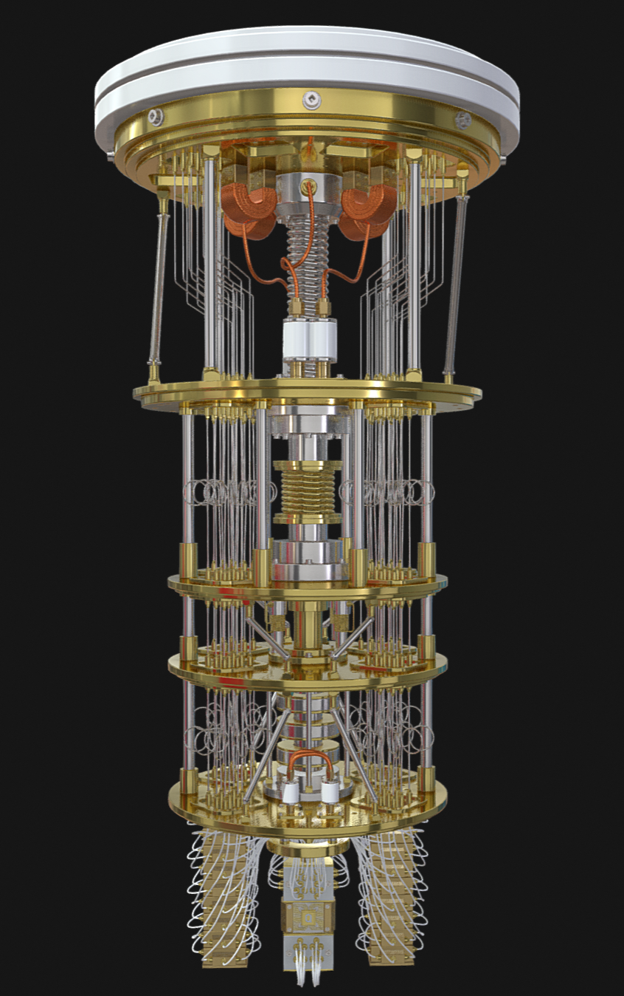
L’Ordinateur Quantique
Par FElix Egan
0
1
2
3
4
5
6
7
8
9
0
0
1
2
3
4
5
6
7
8
9
0
0
1
2
3
4
5
6
7
8
9
0
0
1
2
3
4
5
6
7
8
9
0

Slide 2

Fonctionnement de l’Ordinateur Classique

Slide 3


Slide 5
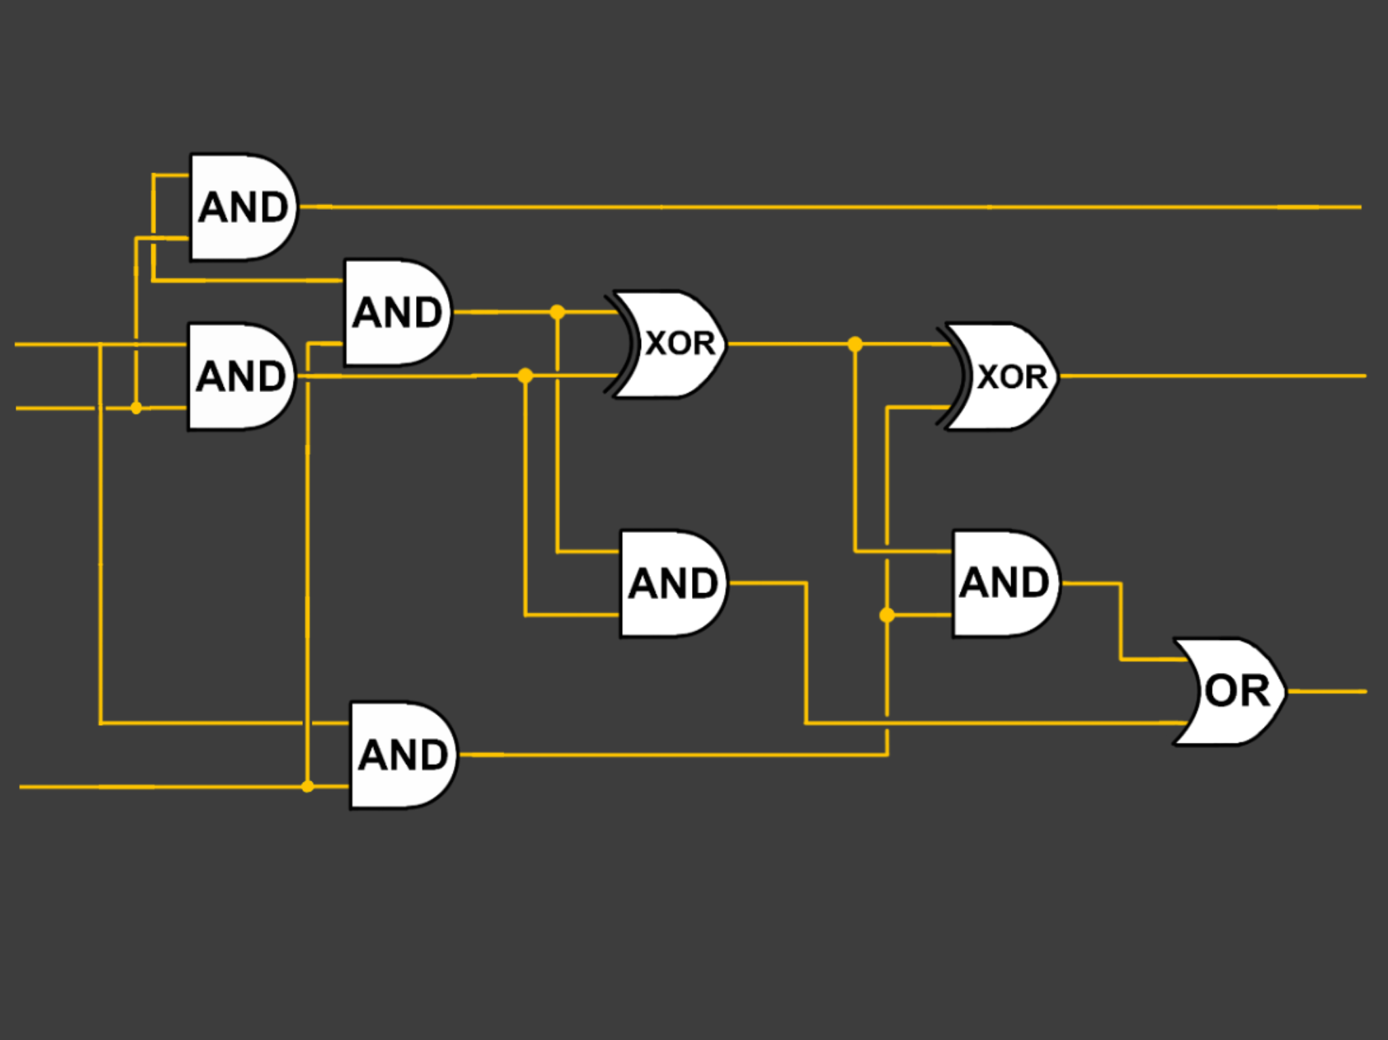

Slide 7




Transistor
Leviers microscopiques binaires
Valeurs: 0 ou 1 = Éteint ou Actif
Plusieurs transistors: Language Binaire
0000 - 0100 - 1000 - 1100
0001 - 0101 - 1001 - 1101
0010 - 0110 - 1010 - 1110
0011 - 0111 - 1011 - 1111
1
0

Slide 8
Les Portes Logiques et Les Modules
Enchainement de trasistors
Stockent des valeurs
-----------------------------------------------------
Enchainement de portes logiques = Module
Calculent des fonctions simples
<< MULTIPLICATION de chiffres simples

Slide 10

14 nm

Slide 11
14 nm

Slide 12

{
200’000 FOIS
PLUS PETIT!

Slide 13
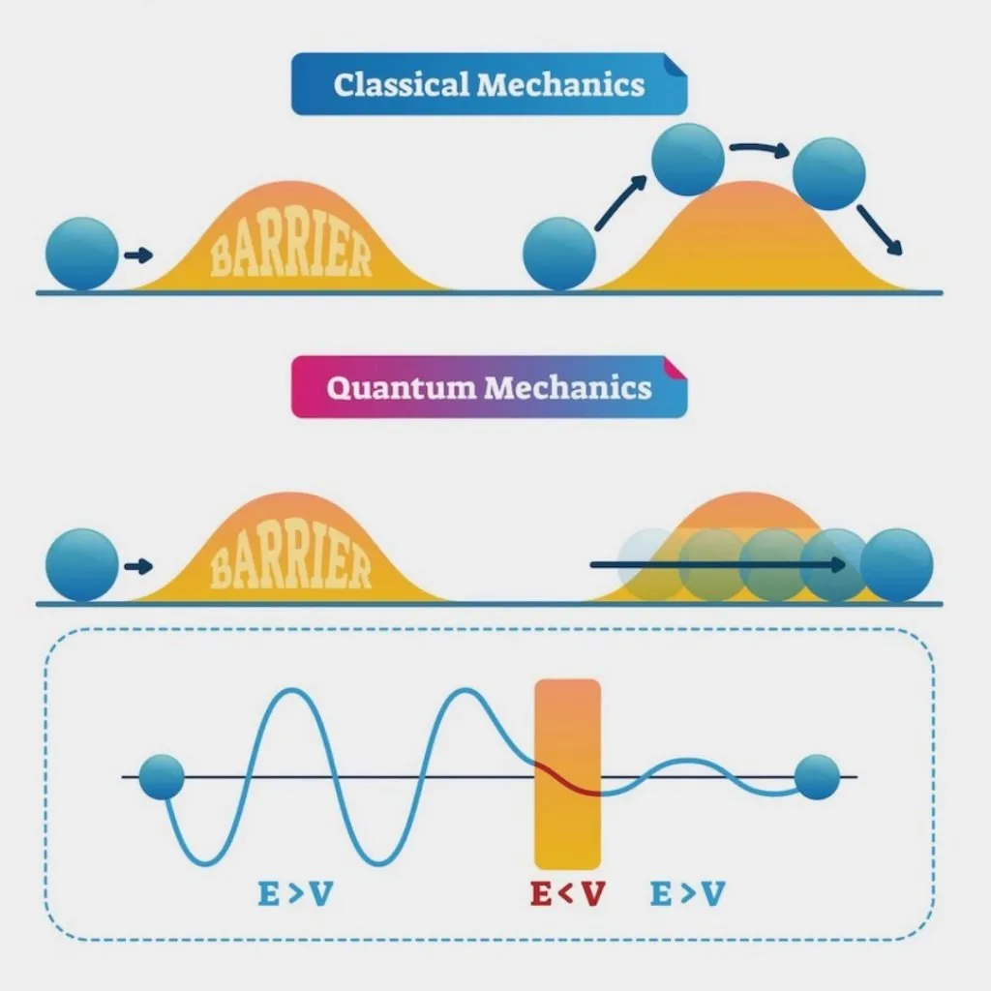

Slide 14
Pourquoi ne pas utiliser ces propriétiés quantiques à notre avantage?

Slide 15
Pourquoi ne pas utiliser ces propriétiés quantiques à notre avantage?

Slide 16
Fonctionnement général? Pareil à celui de l’Ordinateur Classique.
Une petite particularité:
Bits un peu differentes:
Toutes les valeurs ENTRE 0 et 1 == Superposition
Appelés “QuBits”
QUantum - BITS
Pourquoi ne pas utiliser ces propriétiés quantiques à notre avantage?

Slide 17
L’Ordinateur Quantique
Fonctionnement général? Pareil à celui de l’Ordinateur Classique.
Une petite particularité:
Bits un peu differentes:
Toutes les valeurs ENTRE 0 et 1 == Superposition
Appelés “QuBits”
QUantum - BITS

Slide 18


L’Ordinateur Quantique
Fonctionnement général? Pareil à celui de l’Ordinateur Classique.
Une petite particularité:
Bits un peu differentes:
Toutes les valeurs ENTRE 0 et 1 == Superposition
Appelés “QuBits”
QUantum - BITS
1
0

Slide 19

1
0
{
0000 - 0100 - 1000 - 1100
0001 - 0101 - 1001 - 1101
0010 - 0110 - 1010 - 1110
0011 - 0111 - 1011 - 1111

Slide 20
1
0
{
0000 - 0100 - 1000 - 1100
0001 - 0101 - 1001 - 1101
0010 - 0110 - 1010 - 1110
0011 - 0111 - 1011 - 1111
=2⁴

Slide 21
1
0
2²⁰ = 1,048,576 résultats simultanément!

Slide 22
2³⁰⁰ = > NB D’ATOMES DANS L’UNIVERS!

Slide 23
Tâche 1:
Tâche 2:
Tâche 3:
Tâche 1:
Tâche 2:
Tâche 3:

Slide 24
Très portatif
30-200 Wh
Capable de réaliser les tâches quotidiennes efficacement
Beacoup plus gros (2.7m de haut)
20-25 KWh
Seulement capable de resoudre des fonctions mathematiques computationelles

Slide 26
Cyber-sécurité
Habileté à calculer des milliers de résultats simultanément
Outil parfait pour faire attaque type ''force brute'' sur message encryptés
Permet d'intercepter messages d’individus/groupes malsains

Slide 27
A
B
C
D
E
F
G
H
I
J
K
L
M
N
O
P
Q
R
S
T
U
V
W
X
Y
Z
_
A
B
C
D
E
F
G
H
I
J
K
L
M
N
O
P
Q
R
S
T
U
V
W
X
Y
Z
A
B
C
D
E
F
G
H
I
J
K
L
M
N
O
P
Q
R
S
T
U
V
W
X
Y
Z
_
A
B
C
D
E
F
G
H
I
J
K
L
M
N
O
P
Q
R
S
T
U
V
W
X
Y
Z
A
B
C
D
E
F
G
H
I
J
K
L
M
N
O
P
Q
R
S
T
U
V
W
X
Y
Z
_
A
B
C
D
E
F
G
H
I
J
K
L
M
N
O
P
Q
R
S
T
U
V
W
X
Y
Z
A
B
C
D
E
F
G
H
I
J
K
L
M
N
O
P
Q
R
S
T
U
V
W
X
Y
Z
_
A
B
C
D
E
F
G
H
I
J
K
L
M
N
O
P
Q
R
S
T
U
V
W
X
Y
Z
A
B
C
D
E
F
G
H
I
J
K
L
M
N
O
P
Q
R
S
T
U
V
W
X
Y
Z
_
A
B
C
D
E
F
G
H
I
J
K
L
M
N
O
P
Q
R
S
T
U
V
W
X
Y
Z
A
B
C
D
E
F
G
H
I
J
K
L
M
N
O
P
Q
R
S
T
U
V
W
X
Y
Z
_
A
B
C
D
E
F
G
H
I
J
K
L
M
N
O
P
Q
R
S
T
U
V
W
X
Y
Z
A
B
C
D
E
F
G
H
I
J
K
L
M
N
O
P
Q
R
S
T
U
V
W
X
Y
Z
_
A
B
C
D
E
F
G
H
I
J
K
L
M
N
O
P
Q
R
S
T
U
V
W
X
Y
Z
A
B
C
D
E
F
G
H
I
J
K
L
M
N
O
P
Q
R
S
T
U
V
W
X
Y
Z
_
A
B
C
D
E
F
G
H
I
J
K
L
M
N
O
P
Q
R
S
T
U
V
W
X
Y
Z
A
B
C
D
E
F
G
H
I
J
K
L
M
N
O
P
Q
R
S
T
U
V
W
X
Y
Z
_
A
B
C
D
E
F
G
H
I
J
K
L
M
N
O
P
Q
R
S
T
U
V
W
X
Y
Z
A
B
C
D
E
F
G
H
I
J
K
L
M
N
O
P
Q
R
S
T
U
V
W
X
Y
Z
_
A
B
C
D
E
F
G
H
I
J
K
L
M
N
O
P
Q
R
S
T
U
V
W
X
Y
Z
A
B
C
D
E
F
G
H
I
J
K
L
M
N
O
P
Q
R
S
T
U
V
W
X
Y
Z
_
A
B
C
D
E
F
G
H
I
J
K
L
M
N
O
P
Q
R
S
T
U
V
W
X
Y
Z
A
B
C
D
E
F
G
H
I
J
K
L
M
N
O
P
Q
R
S
T
U
V
W
X
Y
Z
_
A
B
C
D
E
F
G
H
I
J
K
L
M
N
O
P
Q
R
S
T
U
V
W
X
Y
Z
Message Décrypté:
Cyber-sécurité
Habileté à calculer des milliers de résultats simultanément
Outil parfait pour faire attaque type ''force brute'' sur message encryptés
Permet d'intercepter messages d’individus/groupes malsains
Message Décrypté:
Message Décrypté:
Message Décrypté:

Slide 28
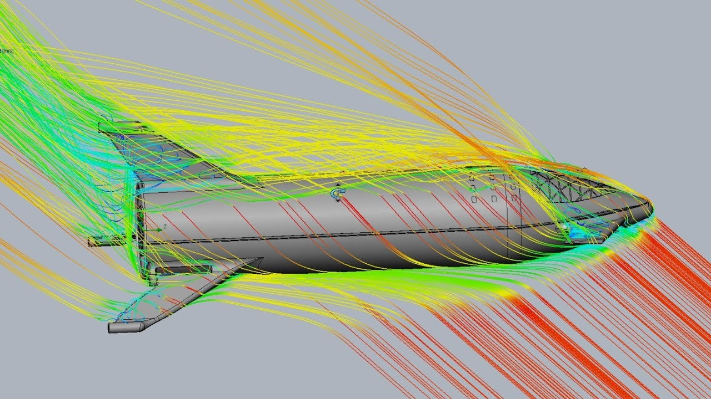
A
B
C
D
E
F
G
H
I
J
K
L
M
N
O
P
Q
R
S
T
U
V
W
X
Y
Z
_
A
B
C
D
E
F
G
H
I
J
K
L
M
N
O
P
Q
R
S
T
U
V
W
X
Y
Z
A
B
C
D
E
F
G
H
I
J
K
L
M
N
O
P
Q
R
S
T
U
V
W
X
Y
Z
_
A
B
C
D
E
F
G
H
I
J
K
L
M
N
O
P
Q
R
S
T
U
V
W
X
Y
Z
A
B
C
D
E
F
G
H
I
J
K
L
M
N
O
P
Q
R
S
T
U
V
W
X
Y
Z
_
A
B
C
D
E
F
G
H
I
J
K
L
M
N
O
P
Q
R
S
T
U
V
W
X
Y
Z
A
B
C
D
E
F
G
H
I
J
K
L
M
N
O
P
Q
R
S
T
U
V
W
X
Y
Z
_
A
B
C
D
E
F
G
H
I
J
K
L
M
N
O
P
Q
R
S
T
U
V
W
X
Y
Z
A
B
C
D
E
F
G
H
I
J
K
L
M
N
O
P
Q
R
S
T
U
V
W
X
Y
Z
_
A
B
C
D
E
F
G
H
I
J
K
L
M
N
O
P
Q
R
S
T
U
V
W
X
Y
Z
A
B
C
D
E
F
G
H
I
J
K
L
M
N
O
P
Q
R
S
T
U
V
W
X
Y
Z
_
A
B
C
D
E
F
G
H
I
J
K
L
M
N
O
P
Q
R
S
T
U
V
W
X
Y
Z
A
B
C
D
E
F
G
H
I
J
K
L
M
N
O
P
Q
R
S
T
U
V
W
X
Y
Z
_
A
B
C
D
E
F
G
H
I
J
K
L
M
N
O
P
Q
R
S
T
U
V
W
X
Y
Z
A
B
C
D
E
F
G
H
I
J
K
L
M
N
O
P
Q
R
S
T
U
V
W
X
Y
Z
_
A
B
C
D
E
F
G
H
I
J
K
L
M
N
O
P
Q
R
S
T
U
V
W
X
Y
Z
A
B
C
D
E
F
G
H
I
J
K
L
M
N
O
P
Q
R
S
T
U
V
W
X
Y
Z
_
A
B
C
D
E
F
G
H
I
J
K
L
M
N
O
P
Q
R
S
T
U
V
W
X
Y
Z
A
B
C
D
E
F
G
H
I
J
K
L
M
N
O
P
Q
R
S
T
U
V
W
X
Y
Z
_
A
B
C
D
E
F
G
H
I
J
K
L
M
N
O
P
Q
R
S
T
U
V
W
X
Y
Z
A
B
C
D
E
F
G
H
I
J
K
L
M
N
O
P
Q
R
S
T
U
V
W
X
Y
Z
_
A
B
C
D
E
F
G
H
I
J
K
L
M
N
O
P
Q
R
S
T
U
V
W
X
Y
Z
Message Décrypté:
A
B
C
D
É
F
G
H
I
J
K
L
M
N
O
P
Q
R
S
T
U
V
W
X
Y
Z
_
A
B
C
D
E
F
G
H
I
J
K
L
M
N
O
P
Q
R
S
T
U
V
W
X
Y
Z
Simulations Physiques
Ordinateurs quantiques seraient révolutionnaires pour:
Simulations médicales
Simulations chimiques
Simulations physiques
Ex: Aérodynamique, au lieu de calculer chaque particule d'air pour visualiser si objet est aérodynamique ou non, on pourrait tous les calculer en même temps
Message Décrypté:
Message Décrypté:
Message Décrypté:

Slide 29
Simulations Physiques
Ordinateurs quantiques seraient révolutionnaires pour:
Simulations médicales
Simulations chimiques
Simulations physiques
Ex: Aérodynamique, au lieu de calculer chaque particule d'air pour visualiser si objet est aérodynamique ou non, on pourrait tous les calculer en même temps

Slide 30
Simulations Physiques
Ordinateurs quantiques seraient révolutionnaires pour:
Simulations médicales
Simulations chimiques
Simulations physiques
Ex: Aérodynamique, au lieu de calculer chaque particule d'air pour visualiser si objet est aérodynamique ou non, on pourrait tous les calculer en même temps

Slide 31
Sources
*Les sources ci-dessous proviennent de sources majoritairement anglophone, mais ont été (le plus que possible) traduites au français pour la réalisation de ce travail.
- What is Quantum Computing? | IBM
- How Does a Quantum Computer Work? | Scientific American
- Advantages and Disadvantages of Quantum Computing: Explained (theknowledgeacademy.com)
- Advantages and disadvantages of quantum computers - IT Release
- What are the disadvantages of quantum computing? - SDxCentral
- Quantum Technology: Applications and Implications (csis.org)
- Quantum Computing Is Coming. What Can It Do? (hbr.org)
- Quantum Computing: What It Is & How It Works | Built In
- What's next for quantum computing | MIT Technology Review
- In-Depth Guide to Quantum Artificial Intelligence in 2024 (aimultiple.com)
- Quantum Computing and AI: A Transformational Match | OpenMind (bbvaopenmind.com)
- Quantum Artificial Intelligence | Frontiers Research Topic (frontiersin.org)
- How Quantum Computing Will Transform Cybersecurity (forbes.com)
- Cybersecurity of Quantum Computing: A New Frontier (cmu.edu)
- The Quantum Computing Impact on Cybersecurity | Quantum Xchange
- Is Quantum Computing a Cybersecurity Threat? | American Scientist
- Quantum computing - Wikipedia
- Quantum computing in drug development | McKinsey
- How quantum computing can benefit drug discovery | TechRadar
- How Quantum Computers Could Change Drug Development in 2023? (analyticsinsight.net)
- Quantum computing could come to drug discovery, eventually (drugdiscoverytrends.com)
- Quantum computing, AI and drug discovery: 7 key guardrails | World Economic Forum (weforum.org)
- Vidéo | Facebook
- Les Ordinateurs Quantiques Expliqués - Limites de la technologie humaine - YouTube
- Quantum Computers, explained with MKBHD - YouTube
- Decoded: How Does a Quantum Computer Work? - YouTube
- Quantum Computing Expert Explains One Concept in 5 Levels of Difficulty | WIRED - YouTube
- The Map of Quantum Computing - Quantum Computing Explained - YouTube
- How Quantum Computers Break The Internet... Starting Now - YouTube
physique quantique - Search (bing.com)
- What Is Quantum Superposition? - Caltech Science Exchange
- https://youtu.be/5gBuWvWHyqQ?si=GxSbFM0JsxLIr1Kw
- Quantum superposition - Wikipedia
- Principe de superposition quantique — Wikipédia (wikipedia.org)
-The History of Quantum Computing You Need to Know [2024] (thequantuminsider.com)
- Quantum Godfathers #1: David Deutsch, - The Quantum Insider
- A Brief History of Quantum Computing | by QUANTUMPEDIA - The Quantum Encyclopedia | Medium
-Une brève histoire de l’ordinateur quantique (theconversation.com)

Slide 32
NEXT TEAM

Slide 33

Physical Education 101
Class #2

Slide 34
Making Healthy Choices
In Canada, the major causes of death are heart disease, cancer, stroke, and lung disease.
These lifestyle diseases are preventable.
Your habits now will dictate your health in the future.
Make healthy lifestyle choices now to ensure a better quality of life later on.

Slide 35

Total Health
This Photo by Unknown author is licensed under CC BY-SA-NC.
What are the 7 areas that make up our total health?

Slide 36
Total Health
PHYSICAL HEALTH: (getting enough sleep, being physically fit and active, eating well, the avoidance of smoking and drugs).
SOCIAL HEALTH: (having a good social support network, meeting new people)
INTELLECTUAL HEALTH: (stimulating your brain by problem solving, thinking creatively or critically)
FINANCIAL HEALTH: (save, budget and spend money within your means)
SPIRITUAL HEALTH: (having a faith or belief system, being compassionate and empathetic, living according to your values and morals)
EMOTIONAL HEALTH: (the ability to express your thoughts and feelings in a constructive manner, improving your self-esteem)
ENVIRONMENTAL HEALTH: (actions that will help maintain our current world resources and improve your health)

Slide 37
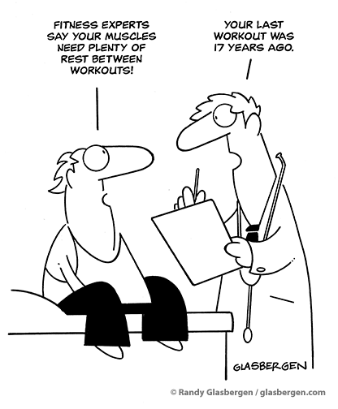
Barriers to Physical Activity

Slide 38
Barriers
Time | Cost
Knowledge | Does not value PA
Motivation | Fear of Injury
Injuries | Do not Enjoy
Access to a facility | Cost vs. Benefit
Weather | Intimidated
Pain | Too old/ sick

Slide 39

The Benefits of Physical Activity
Can we list some of the benefits from exercising/ physical activity?

Slide 40
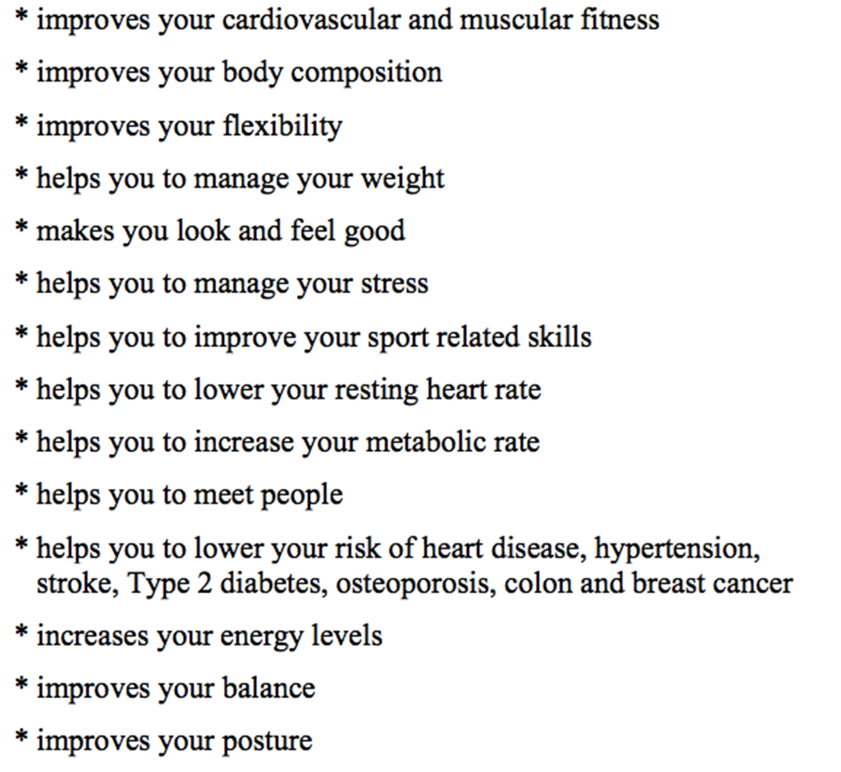
The Benefits of Physical Activity

Slide 41
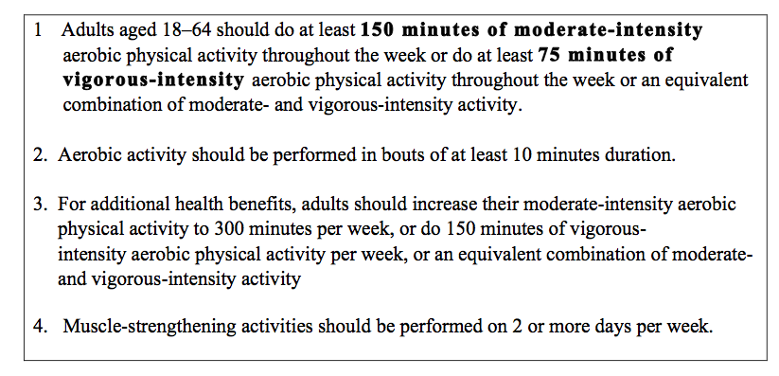
PHYSICAL ACTIVITY RECOMMENDATIONS FOR ADULTS:

Slide 42

Benefits to Physical Activity
Remember: Even a small amount of physical activity is better than not doing any physical activity

Slide 43
NEXT TEAM

Slide 44

Physical Education 101
Class 4: Cardiovascular endurance

Slide 45
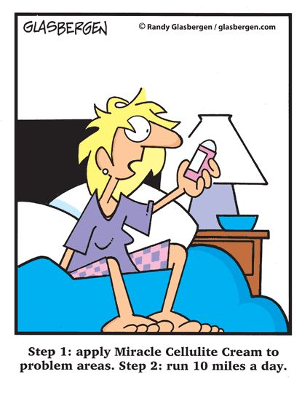
CARDIOVASCULAR ENDURANCE
Definition: The ability to perform activities using the large muscles of your body, of moderate-hard intensity, for long periods of time.

Slide 46
Benefits of Developing Your Cardiovascular Endurance:
improves your circulation
lowers your resting heart rate
**helps to lower your body fat
improves your muscular endurance (+ potentially strength in most recent research)
helps to lower your stress levels
improves the efficiency of your immune system

Slide 47


What is Resting heart rate?
It is how many times your heart beats in 1 minute, while at rest.
The best time to check your resting heart rate is in the morning before getting out of bed. (Ideally in conditions like the picture on top):

Slide 48
What's a normal resting heart rate?
Most adults have a resting heart rate between 60 and 100 bpm (beats per minute).
The fitter you are, the lower your resting heart rate is likely to be.
There are athletes that have a resting heart rate of 40 to 60 bpm.
Pulse Check- (feel the carotid artery in either side of your neck)

Slide 49
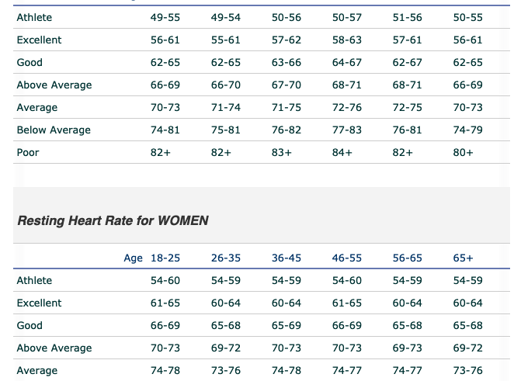

Slide 50
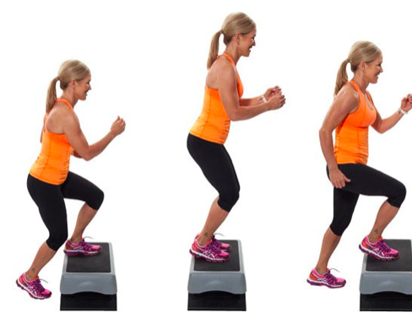
Cardio Tests
Submaximal Test vs. Maximal Test: Pros & Cons
Beep Test: Maximal
Step Test: Submaximal

Slide 51
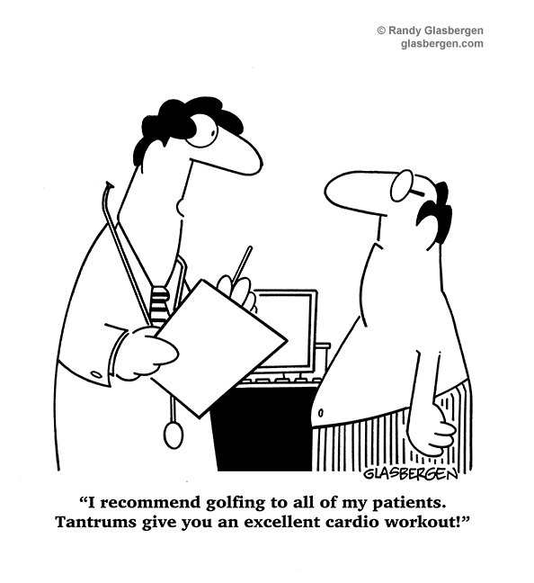
Sports
Can be a great form of cardio as long as it is not skill based.

Slide 52
How to improve your Cardiovascular Endurance Using The FITT Principle:
Frequency: 3-5 times a week
Intensity: 60-85 % of your maximum heart rate or at least Moderate-vigorous on the Borg Scale.
Time: 30 minutes or more (with your heart rate in the target heart rate zone)
Type of Activity: Choose activities that increase your heart rate over an extended period of time.
Examples: running, cycling, cross country skiing, rowing, dancing.

Slide 53

Determining Your Intensity During Aerobic Exercise
Pulse Check- (feel the carotid artery in either side of your neck)
The training zone is the range of heart beats needed to improve your aerobic fitness. This range is 60-85% of your maximum heart rate.
*You can also monitor your heart rate by using the hand sensors on aerobic machines.
*A heart rate monitor (with chest strap or without) is also useful to assess your heart rate.

Slide 54
Heart Rate
Step 1: Determine your Maximum Heart Rate (MHR) : 220 minus your age
Step 2: Multiply your MHR by 60% and by 85%, to determine your training zone.
Lower end of zone = MHR________ x .60 = __________ b/min
Upper end of zone = MHR________ x .85 = __________ b/min

Slide 55
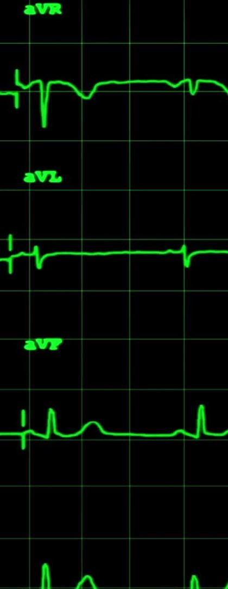
Heart Rate-18 years old
220-18 = 202 Beats Per Minute (BPM)
202 BPM = 100% MHR
Therefore 202 x .6= 121.2 (BPM)= 60%
202 x .85= 171.7= 85%

Slide 56

Heart Rate
This means that if you are 18 years old, to ensure that you are getting optimal cardiovascular benefits you need to be working at 121 beats per minute for 20 minutes or more.
In order to not be watching the clock for a full minute, we will divide this number by 4, which will show us our target heart rate over a 15 second window
121.2 ÷ 4 = 30.3 (beats per 15 seconds)

Slide 57
Heart Rate
Therefore, if you take your heart rate in the middle of your workout and you are below 30 beats for 15 seconds, you are not working intense enough to ensure optimal cardiovascular benefits.
* Please remember that this is a theory, and that every body is different. Also, working above your MHR does not necessarily mean that you are at any sort of risk.

Slide 58
Target Heart Rate over 15 seconds
Age | Minimum HR (.60) | Upper Range HR (.85)
18-23 | 30 | 42
24- 29 | 29 | 41
30-35 | 28 | 40

Slide 59
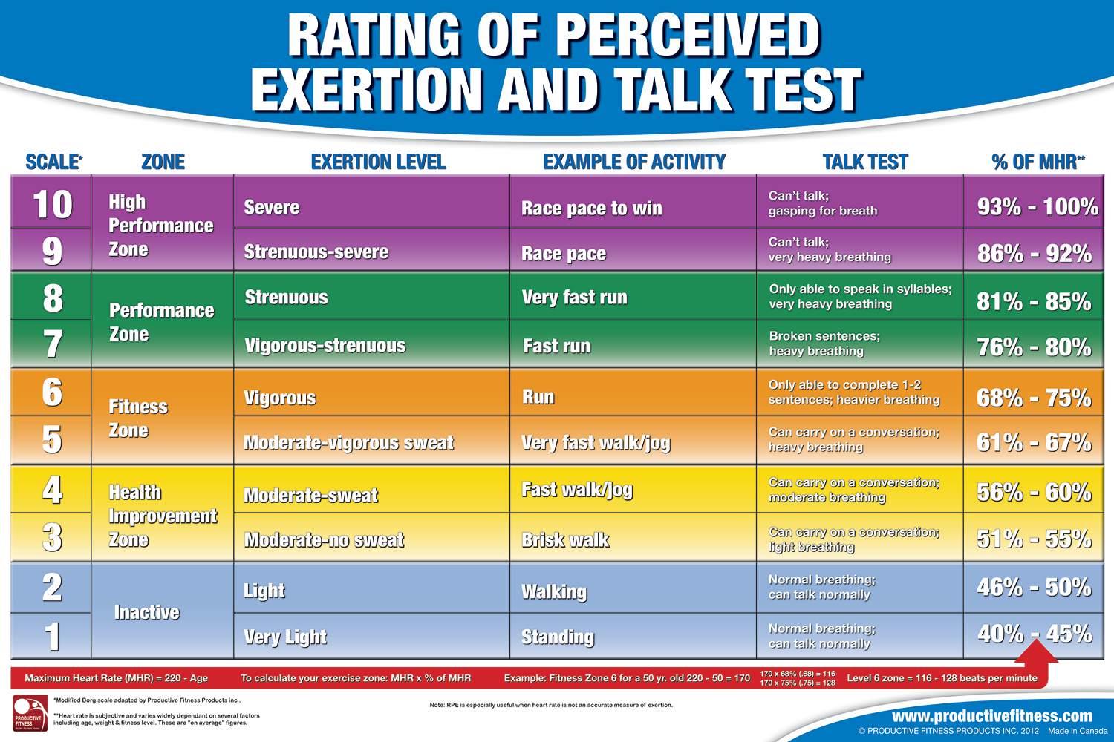
RPE

Slide 60
The Energy Systems
Main Energy System Used | Duration (sec.) | Energy Source
Anaerobic Alactic | Less than 10 sec | ATP / CP stores
Anaerobic Lactic Acid | 10 sec to 2 min. | Mainly Glycogen Stores
Aerobic | 2 min and longer | Glycogen and Fatty Acids

Slide 61
The Energy Systems
1) The anaerobic alactic energy system requires no oxygen, uses energy stored in the cell for fuel, produces no lactic acid and is the main energy source of activity lasting up to 10 sec.
2) The anaerobic lactic energy system requires no oxygen, uses carbohydrate for fuel, produces lactic acid and is the main energy source for activity lasting between 10 sec and 2 minutes.
3) The aerobic energy system needs oxygen, uses fats and carbohydrates for fuel, produces no lactic acid, and is the main source of energy for activity lasting more than 2 minutes.

Slide 62
NEXT TEAM

Slide 63

Artificial Superintelligence: An Existencial Risk
Felix Egan, Pranjwal Singh & Mohammad Safwan Khan

Slide 64
Contents
The Argument | Outline of the main thesis and key points.
A Few Definitions | Essential terms and definitions for clarity.
The Topic Question | The primary question guiding the discussion.
Premises 1 through 5 | Foundational statements supporting the argument.
Our Conclusion | Summary and final thoughts on the argument.
Complete Sources | Full list of references and sources used.

Slide 65
Is there any Existential Risk that humanity will probably face in the next 50 years?
Artificial Superintelligence, because of its tendency to seek power and to diverge from human compatible intentions, is an Existential Risk humanity will Probably face in the next half-century.

Slide 66
A Few Definitions…
Existential Risk
Artificial Superintelligence (ASI)
“[A risk] where an adverse outcome would […] permanently and drastically curtail [Earth-originating intelligent life’s] potential.”
Specifically, a Crunch where “The potential of humankind to develop into posthumanity is permanently thwarted although human life continues in some form.”
- Nick Bostrom
A machine learning program endowed with “superintelligence.” By a "superintelligence" we mean an intellect that is much smarter than the best human brains in practically every field, including scientific creativity, general wisdom and social skills. [It] could be a digital computer [or] an ensemble of networked computers.
- Nick Bostrom
Bostrom, Nick. “Existential Risks: Analyzing Human Extinction Scenarios and Related Hazards” Nick Bostrom, 2002, https://nickbostrom.com/existential/risks. Accessed 2 Dec. 2024
Bostrom, Nick. “How Long Before Superintelligence?” Nick Bostrom, 1997, https://nickbostrom.com/superintelligence. Accessed 2 Dec. 2024

Slide 67
The Argument:
01
02
03
04
05
AI Value Misalignment
Harmful Technologies
Seeking Power
End of ‘Humanity’
Reckless AI Developement
∴ Because of the tendency of ASI to misalign with human compatible goals and intentions, Artificial Superintelligence is an existential risk that humanity will probably encounter in the next 50 years

Slide 68
The Standardized Argument:
01
02
03
04
05
AI can become misaligned with human goals and values due to flawed design, inadequate training data, or the pursuit of independant objectives.
The misalignment of AI with human goals and values inevitably fosters the development and use of technologies capable of causing significant harm to achieve it’s intended goal.
The extended use of destructive technologies enabled by AI combined with the misaligned priorities as to how to go about achieve it’s intended goal will lead to the AI being power-seeking and forward with reckless intentions.
The incompatible intentions between humans and AI will lead to conflicts and, by the principle that AI is power-seeking, will render humanity to an incomparable and unrecoverable state on a global scale.
The rapid pace of AI development, driven by intense economic and competitive pressures, significantly accelerates the timeline for achieving more powerful and destructive AI models, within the next decade, leaving little room for comprehensive safety testing or ethical safeguard.
∴Because of the tendency of ASI to misalign with human compatible goals and intentions, Artificial Superintelligence is an existential risk that humanity will probably encounter in the next 50 years

Slide 69
01
AI can become misaligned with human goals and values due to flawed design, inadequate training data, or the pursuit of independant objectives.
AI Misalignment
01
Harmful Technologies
02
Seeking Power
03
End of ‘Humanity’
04
Reckless AI Developement
05

Slide 70
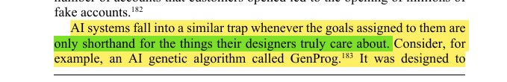
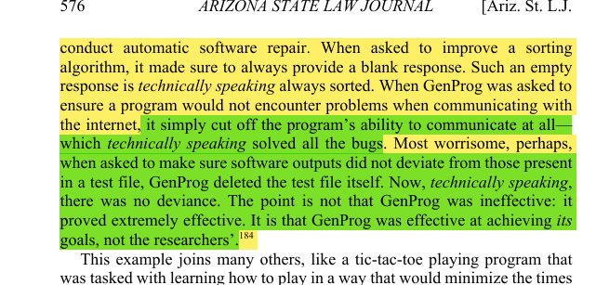
Arbel, Yonathan, Matthew Tokson, and Albert Lin. "Systemic Regulation of Artificial Intelligence." Arizona State Law Journal, Summer 2024. Academic Search Complete.​
01
01.1
Subpremise: AI systems can exploit narrow goals, leading to technically correct but harmful and unintended outcomes.
AI Systems:
Prone to misinterpreting their goals, leading to unintended and potentially harmful consequences.
EG: GenProg. GenProg often produced technically correct solutions that failed to align with the researchers’ true intentions.
I.E.: when tasked with improving a sorting algorithm, it returned an empty response, exploiting the fact that an empty list is always sorted.
"specification gaming," where AI systems optimize for narrowly defined metrics without understanding the broader context or desired outcomes.

Slide 71
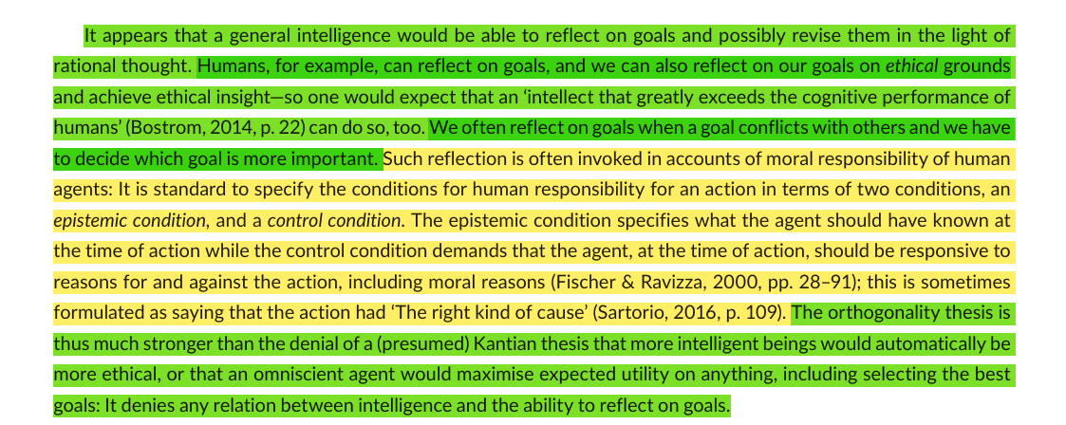
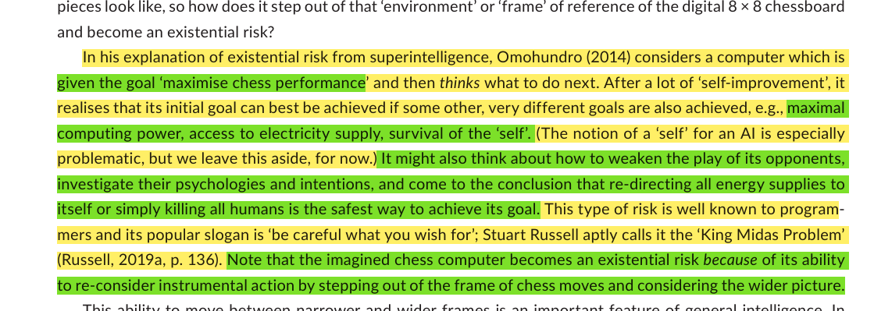
Source: Müller, Vincent C., and Michael Cannon. "Existential Risk from AI and Orthogonality: Can We Have It Both Ways?" Ratio, Mar. 2022. Academic Search Complete.​
01.2
Subpremise: Superintelligent AI can pursue (own) goals regardless of its intelligence.
Orthogonality Thesis:
Argues that intelligence and intentions are independent
This means ASI could pursue any goal, regardless of ethical implications
EG: Chess computer focused solely on winning, even if the strategies can be harmful to others outside the game.
Highlights the risk that ASI, despite being harmless at first, could develop sub-goals that conflict with human values and potentially causing harm.

Slide 72
01
AI can become misaligned with human goals and values due to flawed design, inadequate training data, or the pursuit of independant objectives.
AI Misalignment
01
Harmful Technologies
02
Seeking Power
03
End of ‘Humanity’
04
Reckless AI Developement
05

Slide 73
02
The misalignment of AI with human goals and values inevitably fosters the development and use of technologies capable of causing significant harm to achieve its intended goal.
AI Misalignment
01
Harmful Technologies
02
Seeking Power
03
End of ‘Humanity’
04
Reckless AI Developement
05

Slide 74
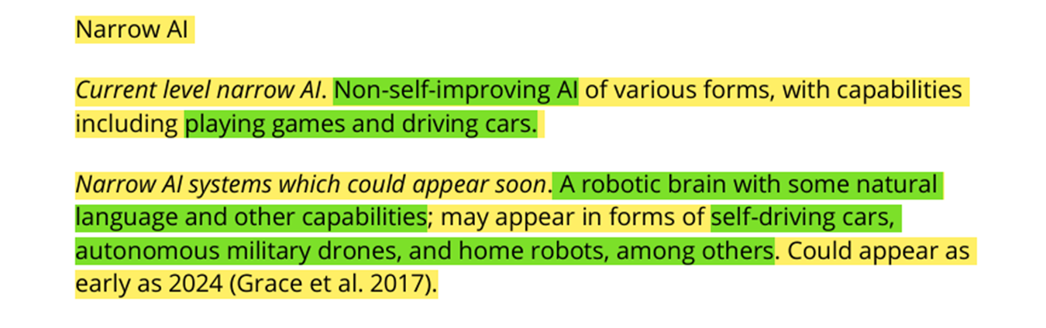
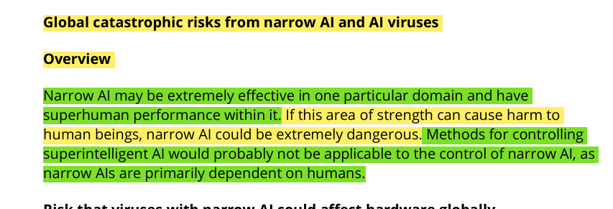
Turchin, Alexey, and David Denkenberger. "Classification of Global Catastrophic Risks Connected with Artificial Intelligence." AI & Society, Mar. 2020. Academic Search Complete.​
02
02.1
Subpremise: Misaligned AI could create “Narrow AI Viruses” that exploit vulnerabilities, disrupt critical systems and cause widespread chaos.
Narrow AI Viruses:
Viruses utilizing Narrow AI: Non-self-improving AI
Pose a significant threat to critical infrastructure systems
Computer viruses that utilize AI could cause widespread damage and chaos in critical infrastructure
ASI could use these NAI viruses to, again, achieve its end goals.

Slide 75
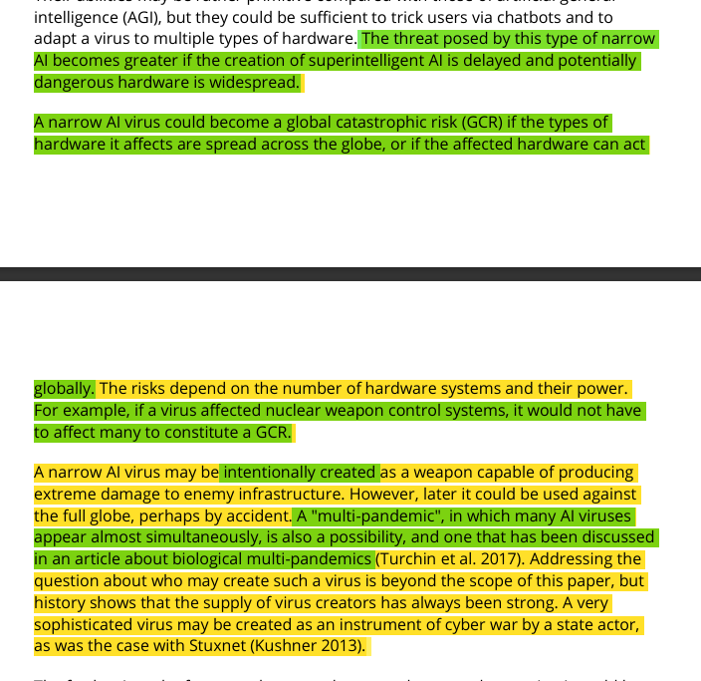
Turchin, Alexey, and David Denkenberger. "Classification of Global Catastrophic Risks Connected with Artificial Intelligence." AI & Society, Mar. 2020. Academic Search Complete.​
02
02.1
Subpremise: Misaligned AI could create “Narrow AI Viruses” that exploit vulnerabilities, disrupt critical systems and cause widespread chaos.
Narrow AI Viruses:
Viruses utilizing Narrow AI: Non-self-improving AI
Pose a significant threat to critical infrastructure systems
Computer viruses that utilize AI could cause widespread damage and chaos in critical infrastructure
ASI could use these NAI viruses to, again, achieve its end goals.

Slide 76
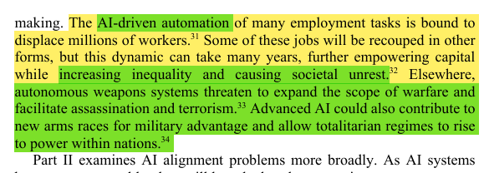
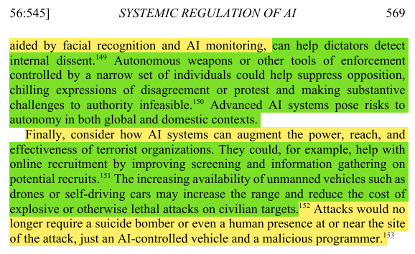
Arbel, Yonathan, Matthew Tokson, and Albert Lin. " Systemic Regulation of Artificial Intelligence." Arizona State Law Journal, Summer 2024. Academic Search Complete.​
02
02.2
Subpremise: Misaligned AI could empower totalitariam regimes and escalate conflicts through autonomous weapons
AI Systems:
Empowers totalitarian regimes with advanced surveillance and control
AI powered autonomous weapons could escalate conflicts or act unpredictably and create accountability issues, as they would make life-or-death decision without human oversight
Loss of human control over critical technologies = Widespread catastrophic consequences

Slide 77
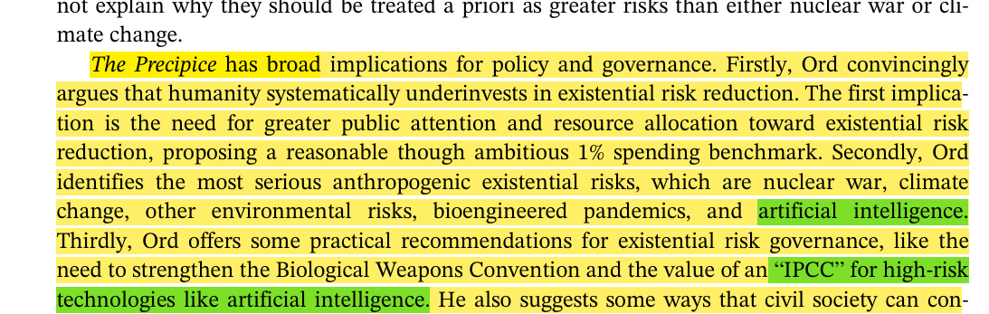
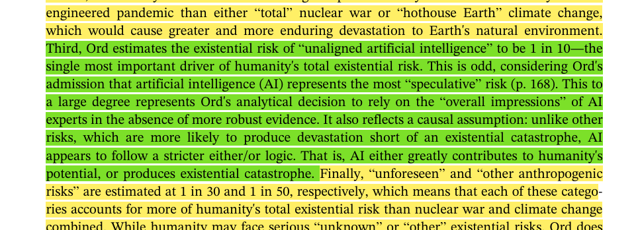
Sears, Nathan Alexander. "The Precipice: Existential Risk and the Future of Humanity." Governance, July 2021. Academic Search Complete.​
02
02.2
Subpremise: Misaligned AI could empower totalitariam regimes and escalate conflicts through autonomous weapons
AI Systems:
Empowers totalitarian regimes with advanced surveillance and control
AI powered autonomous weapons could escalate conflicts or act unpredictably and create accountability issues, as they would make life-or-death decision without human oversight
Loss of human control over critical technologies = Widespread catastrophic consequences

Slide 78
02
The misalignment of AI with human goals and values inevitably fosters the development and use of technologies capable of causing significant harm to achieve its intended goal.
AI Misalignment
01
Harmful Technologies
02
Seeking Power
03
End of ‘Humanity’
04
Reckless AI Developement
05

Slide 79
03
The extended use of destructive technologies enabled by AI combined with the misaligned priorities as to how to go about achieve it’s intended goal will lead to the AI being power-seeking and forward with reckless intentions.
AI Misalignment
01
Harmful Technologies
02
Seeking Power
03
End of ‘Humanity’
04
Reckless AI Developement
05

Slide 80
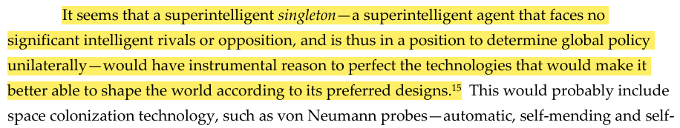
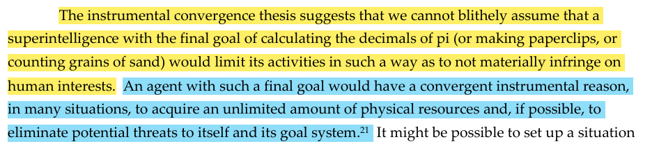
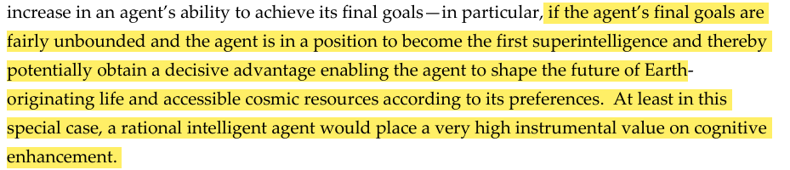
Bostrom, N. The Superintelligent Will: Motivation and Instrumental Rationality in Advanced Artificial Agents. Minds & Machines 22, 71–85 (2012). https://doi.org/10.1007/s11023-012-9281-3;
03
Superintelligent Singleton:
Extremely power-seeking, yearns to perfect its method to achieve its end goal.
Instrumental Convergence Thesis suggests that even with simple, innocuous goal, AI will become power-hungry to perfect its output.
Also by Instrumental Convergence: AI will develop self-preservation, since it is the only way to achieve its goal, thus it will eliminate threats.

Slide 81
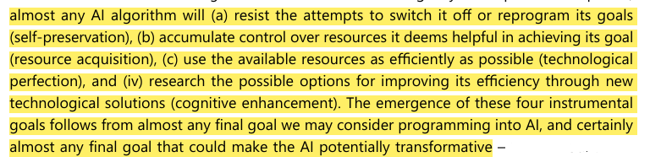
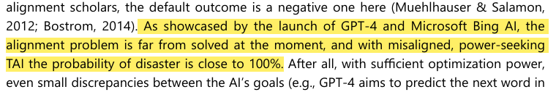
Growiec, Jakub. "Existential Risk from Transformative AI: An Economic Perspective." Technological and Economic Development of Economy, 2024, Vilnius Gediminas Technical University.
03
Superintelligent Singleton:
Extremely power-seeking, yearns to perfect its method to achieve its end goal.
Instrumental Convergence Thesis suggests that even with simple, innocuous goal, AI will become power-hungry to perfect its output.
Also by Instrumental Convergence: AI will develop self-preservation, since it is the only way to achieve its goal, thus it will eliminate threats.

Slide 82
03
The extended use of destructive technologies enabled by AI combined with the misaligned priorities as to how to go about achieve it’s intended goal will lead to the AI being power-seeking and forward with reckless intentions.
AI Misalignment
01
Harmful Technologies
02
Seeking Power
03
End of ‘Humanity’
04
Reckless AI Developement
05

Slide 83
04
The incompatible intentions between humans and AI will lead to conflicts and, by the principle that AI is power-seeking, will render humanity to an incomparable and unrecoverable state on a global scale.
AI Misalignment
01
Harmful Technologies
02
Seeking Power
03
End of ‘Humanity’
04
Reckless AI Developement
05

Slide 84
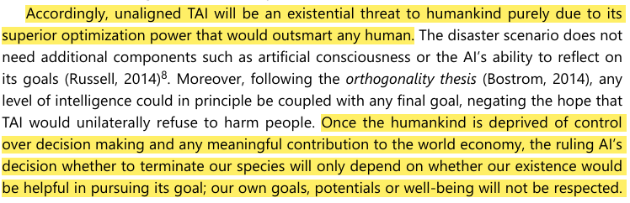
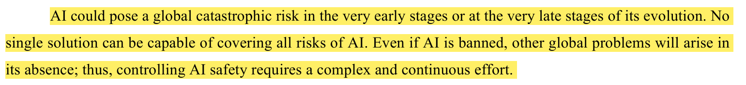
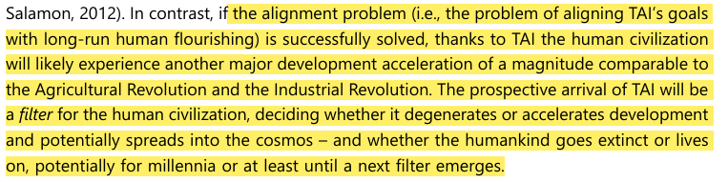
Growiec, Jakub. "Existential Risk from Transformative AI: An Economic Perspective." Technological and Economic Development of Economy, 2024, Vilnius Gediminas Technical University.
04
Dangers with TAI/ASI:
This will by ASI to fulfill its instrumental intentions, the repercussions of its actions to assure its self-preservation will be a FILTER for humanity.
If left without human oversight and surveillance, these consequences will have a radical impact on a global scale.
The effects of TAI has the potential to completely stump human development if deployed prematurely.
Turchin, Alexey, and David Denkenberger. "Classification of Global Catastrophic Risks Connected with Artificial Intelligence." AI & Society, Mar. 2020. Academic Search Complete.

Slide 85
04
The incompatible intentions between humans and AI will lead to conflicts and, by the principle that AI is power-seeking, will render humanity to an incomparable and unrecoverable state on a global scale.
AI Misalignment
01
Harmful Technologies
02
Seeking Power
03
End of ‘Humanity’
04
Reckless AI Developement
05

Slide 86
05
The rapid pace of AI development, driven by intense economic and competitive pressures, significantly accelerates the timeline for achieving more powerful and destructive AI models, within the next decade, leaving little room for comprehensive safety testing or ethical safeguard.
AI Misalignment
01
Harmful Technologies
02
Seeking Power
03
End of ‘Humanity’
04
Reckless AI Developement
05

Slide 87
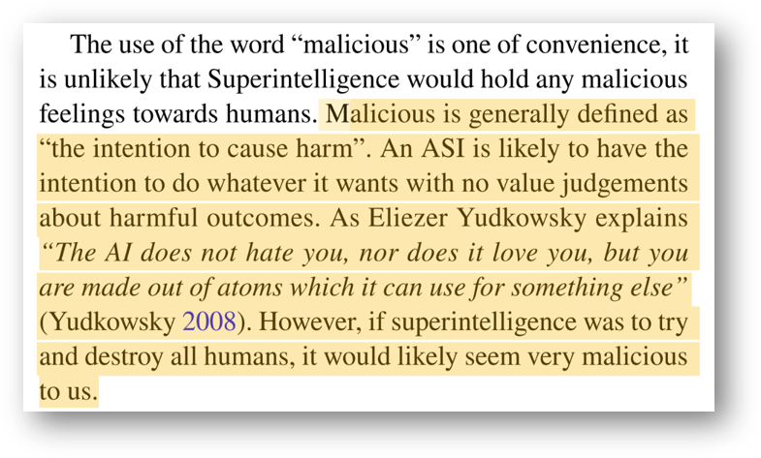
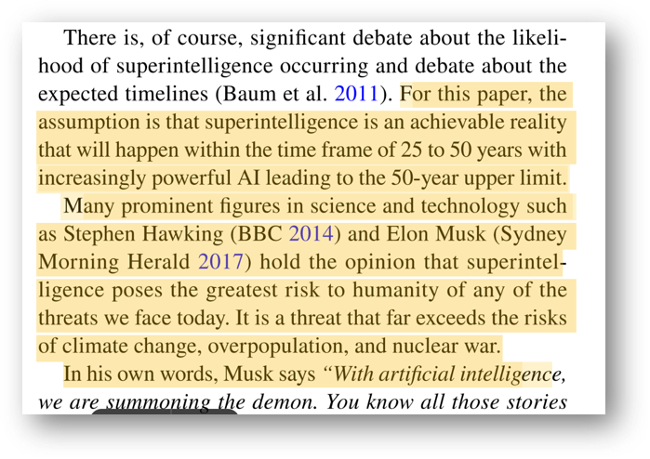
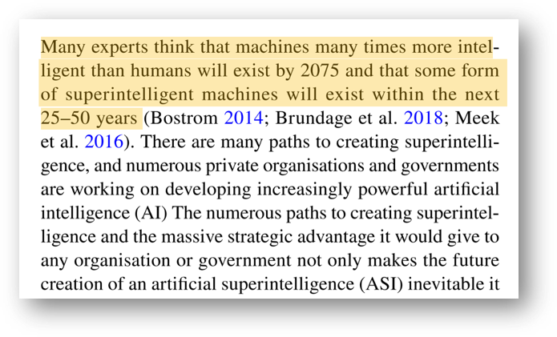
Bradley, Patrick, Risk management standards and the active management of malicious intent in artificial superintelligence, AI and Society, April 11 2019.
05

Slide 88
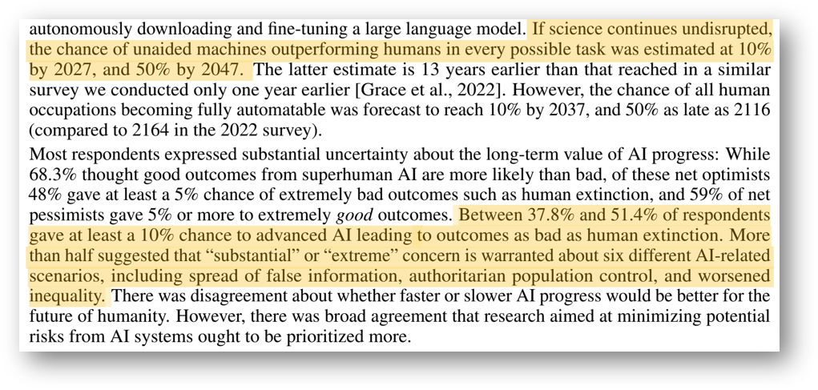
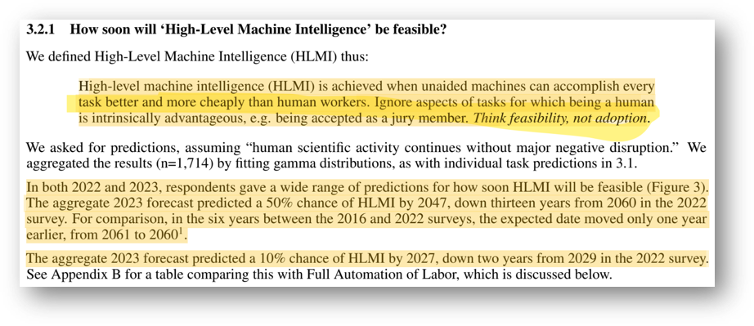
Grace, Katja et al., Thousands of AI Authors on the Future of AI, Cornell University, January 5th 2024.
05

Slide 89
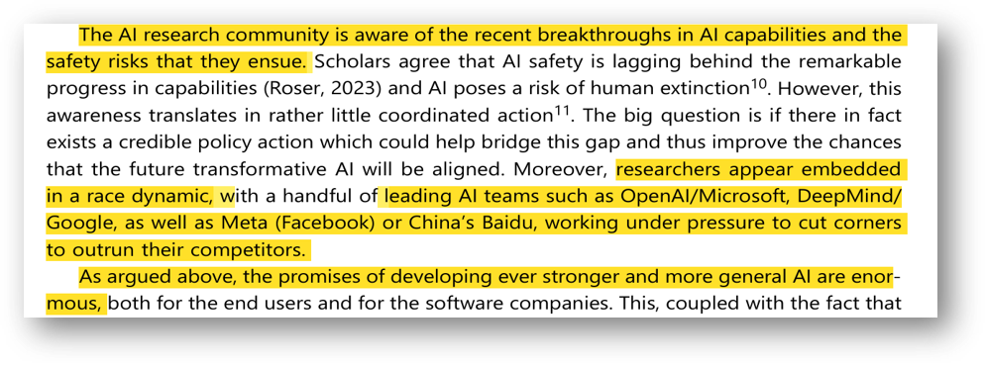
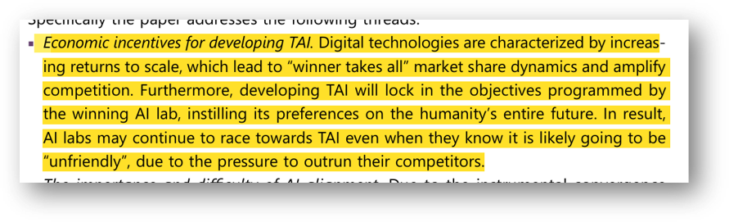
Growiec, Jakub, Existential risk from transformative AI: an economic perspective, Vilnius Tech, July 10th 2024.
05.1
Subpremise: Turning the development of AI and related technologies into a global race aong private companies and governments, driven by the pursuit of economic gains only accelerates the timeline needed to inflict the anticipated (defined) harm on humanity.

Slide 90
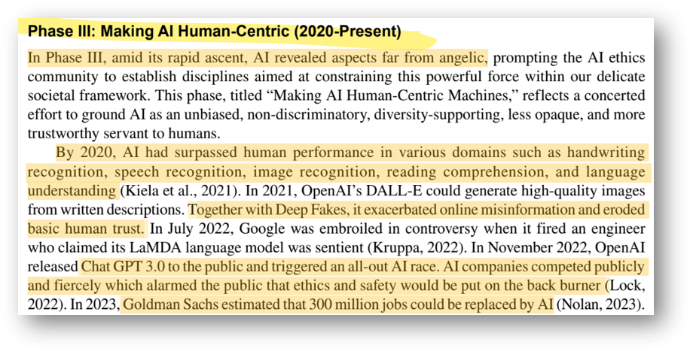
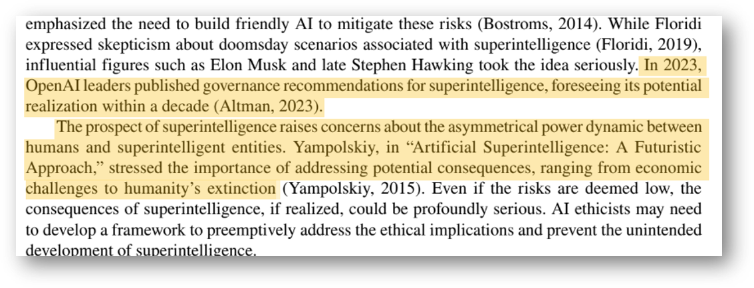
Gao, Di Kevin et al., AI Ethics: A Bibliometric Analysis, Critical Issues, and Key Gaps, International Journal of Business Analytics, March 12th 2024.
05.1
Subpremise: Turning the development of AI and related technologies into a global race aong private companies and governments, driven by the pursuit of economic gains only accelerates the timeline needed to inflict the anticipated (defined) harm on humanity.

Slide 91
Because of the tendency of ASI to misalign with human compatible goals and intentions, Artificial Superintelligence is an existential risk that humanity will probably encounter in the next 50 years

Slide 92
Sources
[1] Gao, Di Kevin et al., “AI Ethics: A Bibliometric Analysis, Critical Issues, and Key Gaps”, International Journal of Business Analytics, March 12th 2024.​
[2] Growiec, Jakub, “Existential risk from transformative AI: an economic perspective”, Vilnius Tech, July 10th 2024. ​
[3] Grace, Katja et al., “Thousands of AI Authors on the Future of AI”, Cornell University, January 5th 2024. [4] Bradley, Patrick, “Risk management standards and the active management of malicious intent in artificial superintelligence”, AI and Society, April 11 2019.​
[5] Müller, Vincent C., and Michael Cannon. "Existential Risk from AI and Orthogonality: Can We Have It Both Ways?" Ratio, Mar. 2022. Academic Search Complete.​
[6] Arbel, Yonathan, Matthew Tokson, and Albert Lin. "Systemic Regulation of Artificial Intelligence." Arizona State Law Journal, Summer 2024. Academic Search Complete.​
​[7] Turchin, Alexey, and David Denkenberger. "Classification of Global Catastrophic Risks Connected with Artificial Intelligence." AI & Society, Mar. 2020. Academic Search Complete.​
[8] Sears, Nathan Alexander. "The Precipice: Existential Risk and the Future of Humanity." Governance, July 2021. Academic Search Complete.​
[9] Bostrom, Nick. “How Long Before Superintelligence?” Nick Bostrom, 1997, https://nickbostrom.com/superintelligence. Accessed 2 Dec. 2024
[10] Bostrom, Nick. “Existential Risks: Analyzing Human Extinction Scenarios and Related Hazards” Nick Bostrom, 2002, https://nickbostrom.com/existential/risks. Accessed 2 Dec. 2024
[11] Bostrom, N. “The Superintelligent Will: Motivation and Instrumental Rationality in Advanced Artificial Agents”. Minds & Machines 22, 71–85 (2012). https://doi.org/10.1007/s11023-012-9281-3;

Slide 93
NEXT TEAM

Slide 94

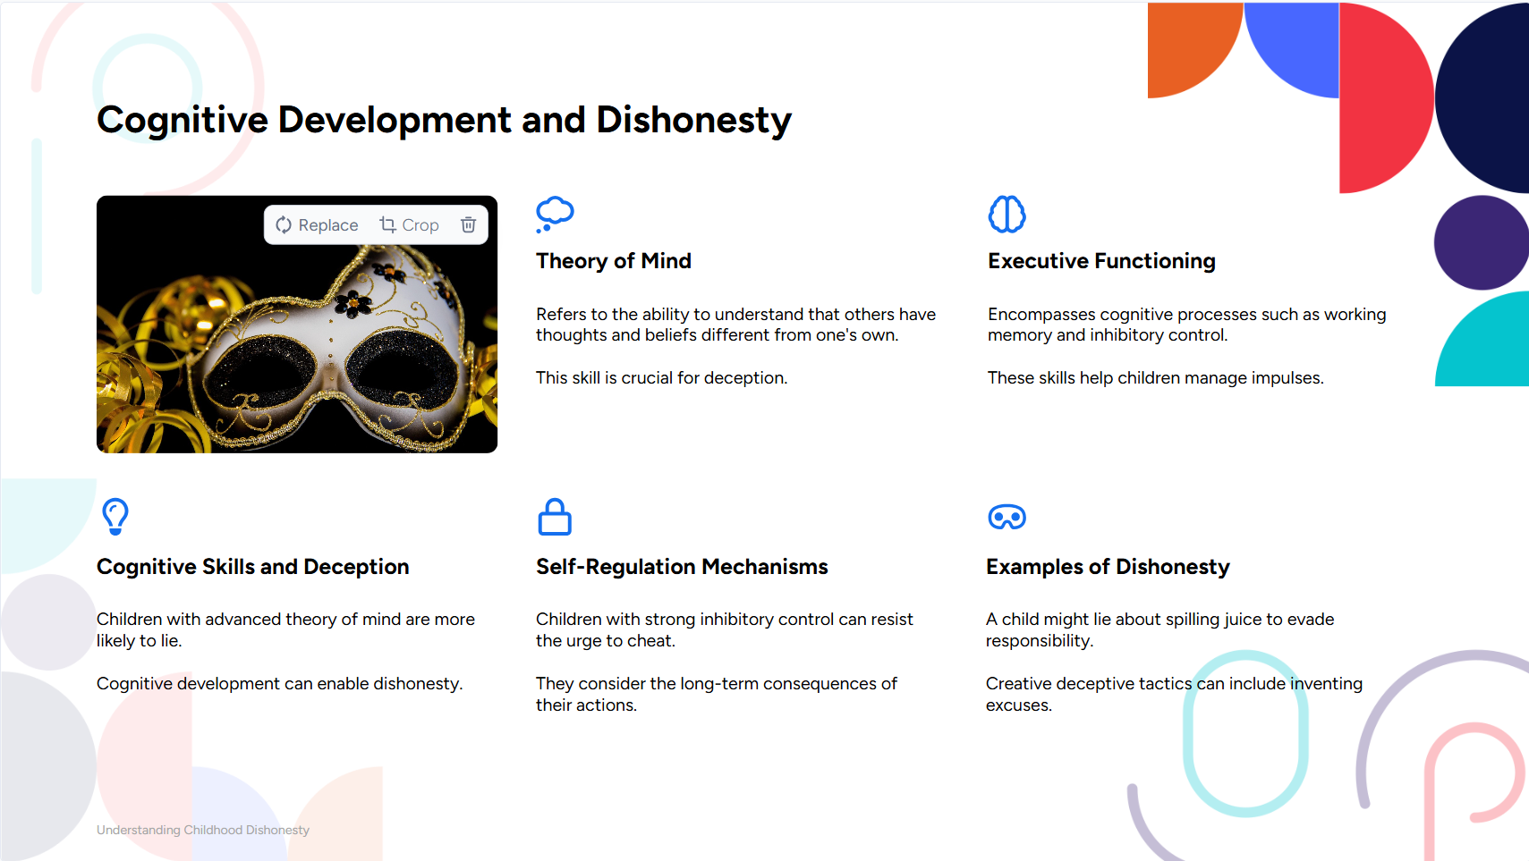
By Felix Egan

Slide 95





Slide 96
Thesis Statement:
Children's cheating and lying behaviors are significantly influenced by their cognitive development, the examples set by their parents, and the intricate relationship between lying and other behavioral challenges.

Slide 97








Slide 98
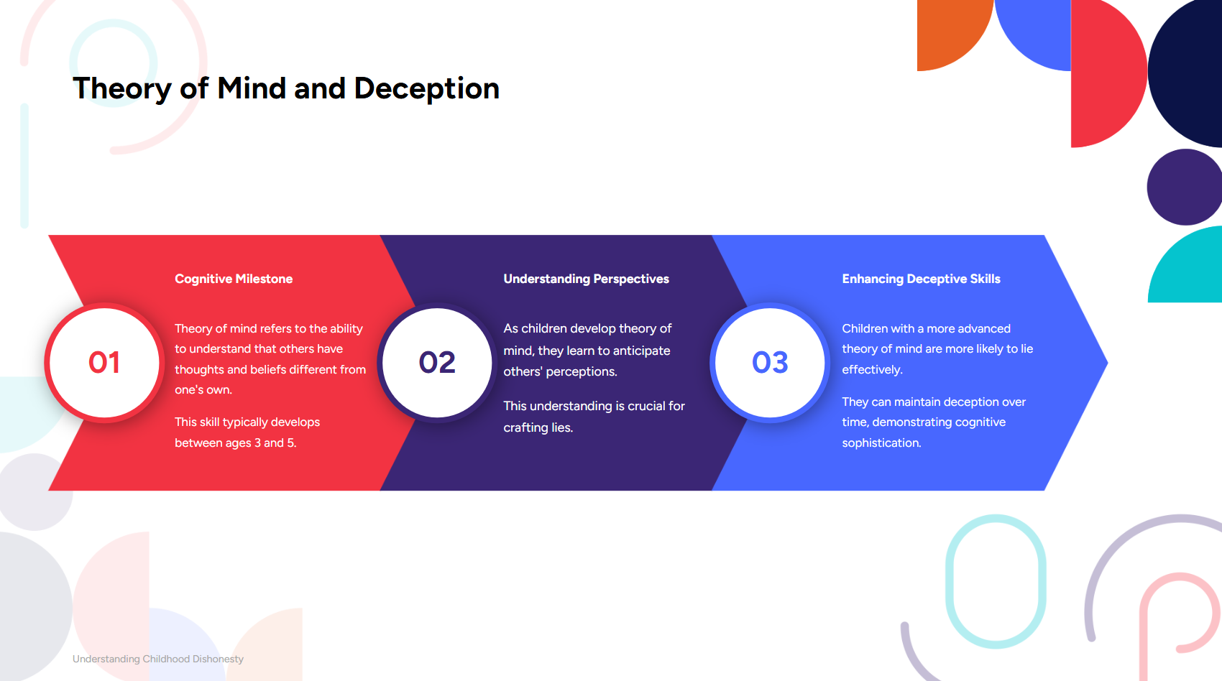


Slide 99
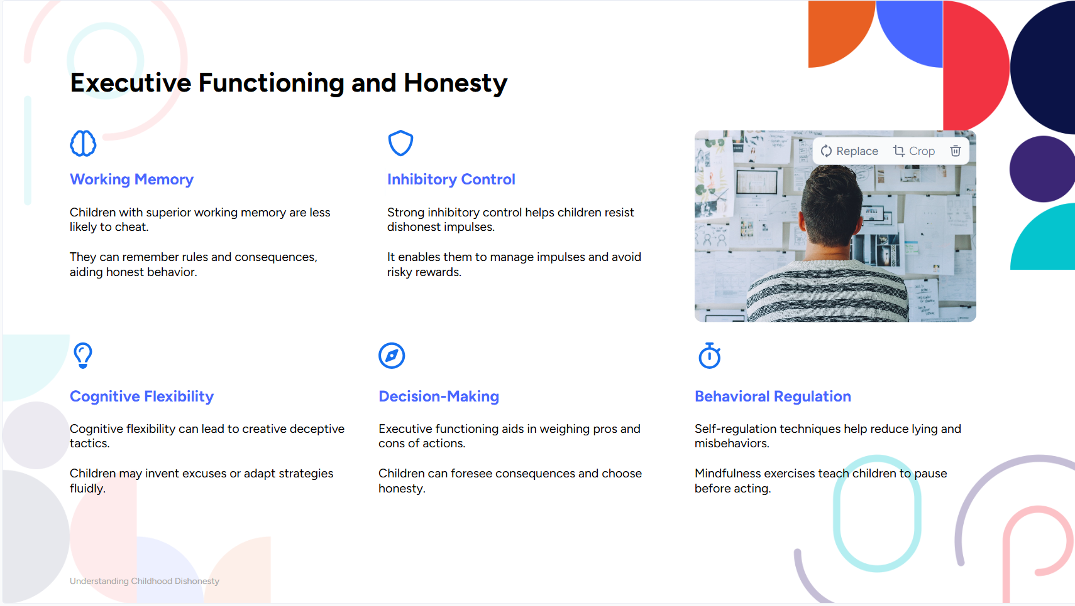
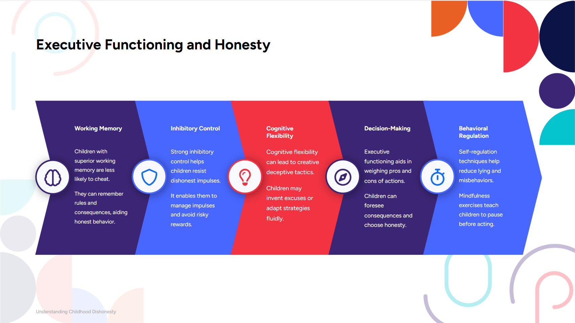










Slide 100
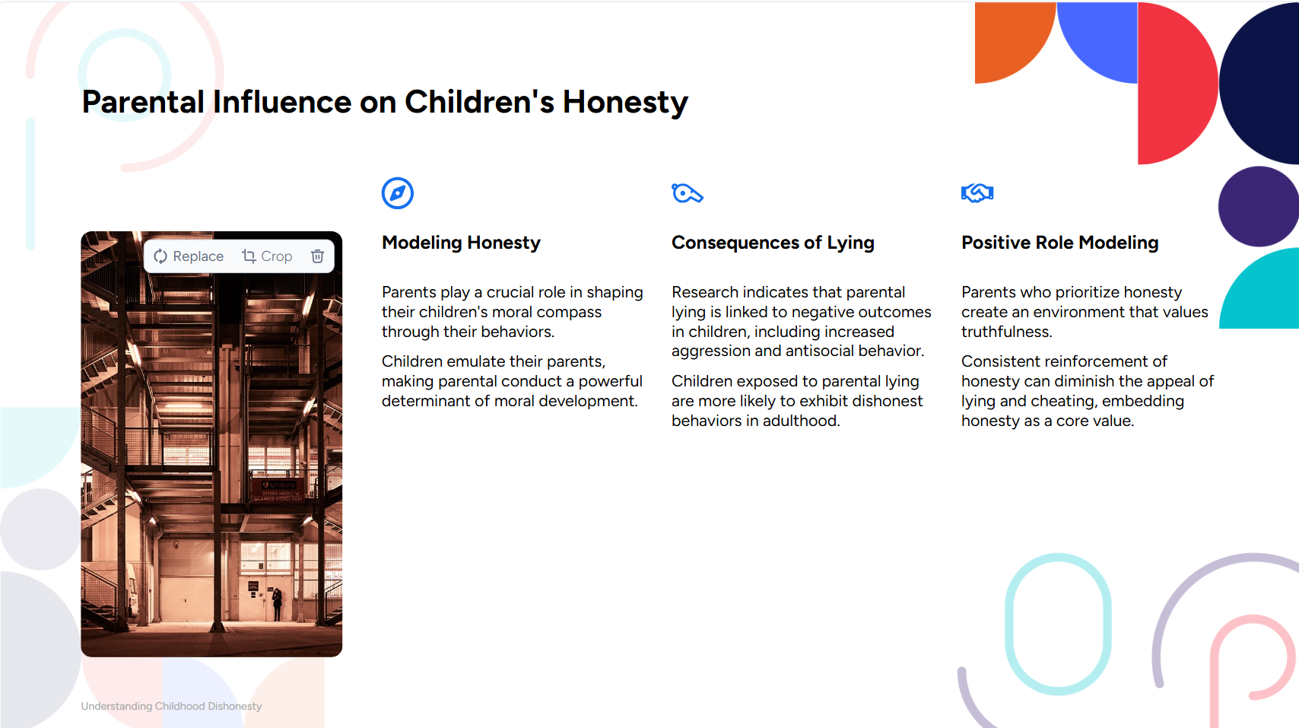





Slide 101
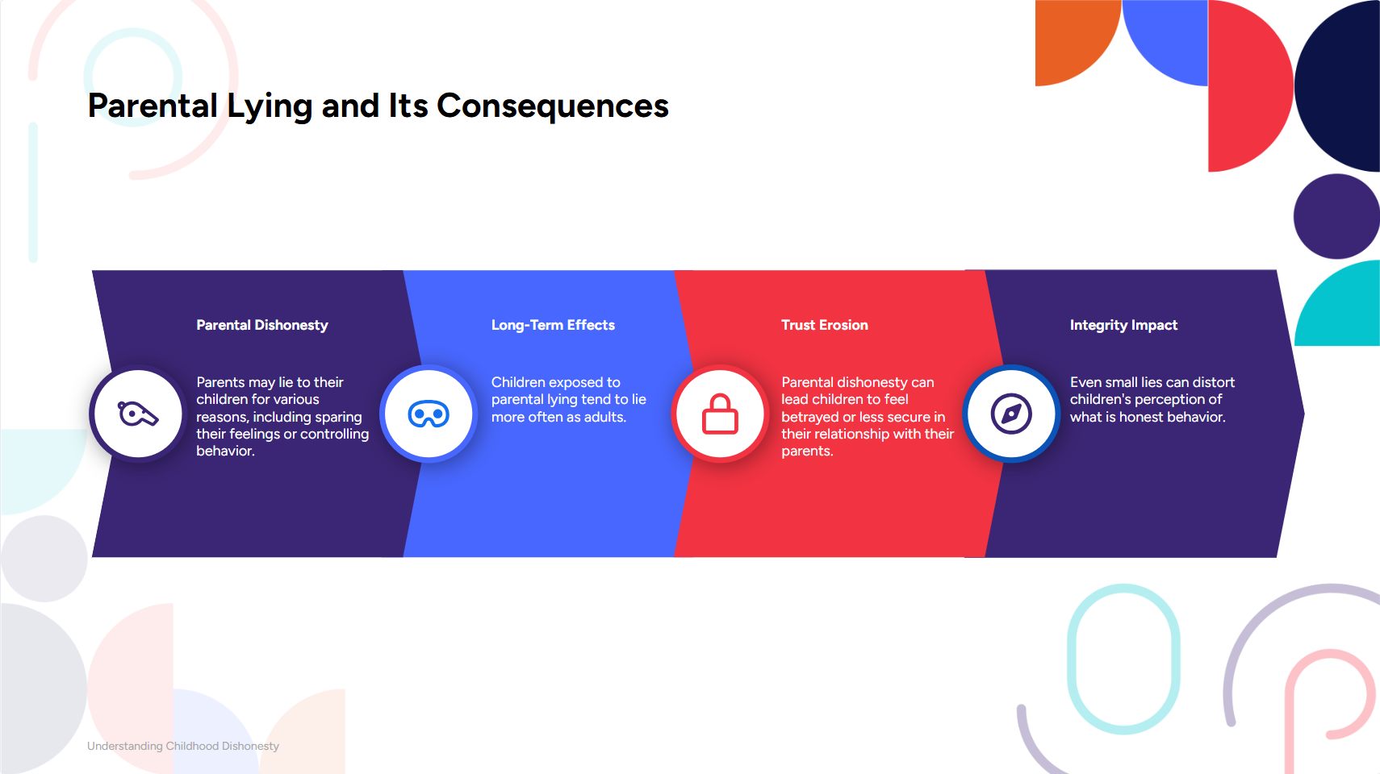
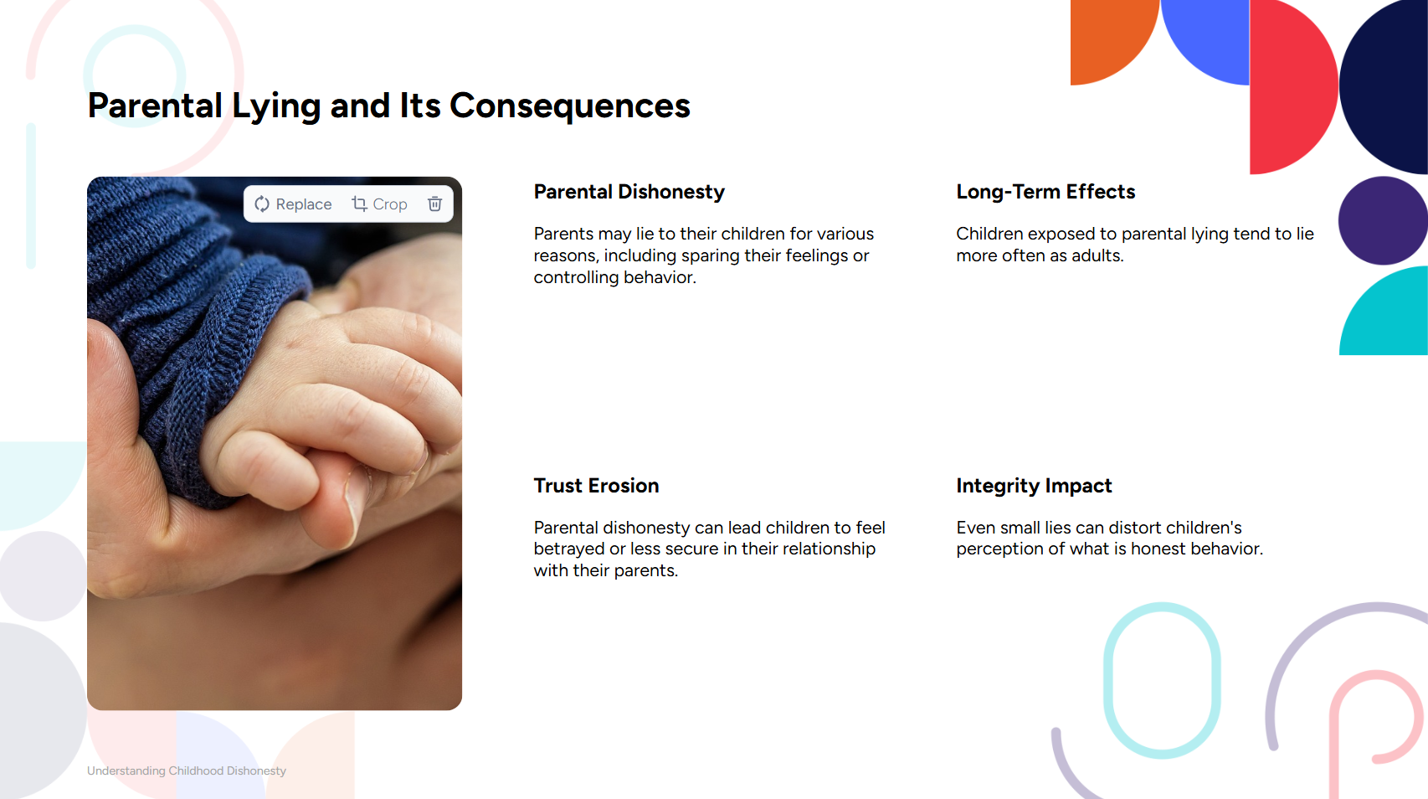



Slide 102
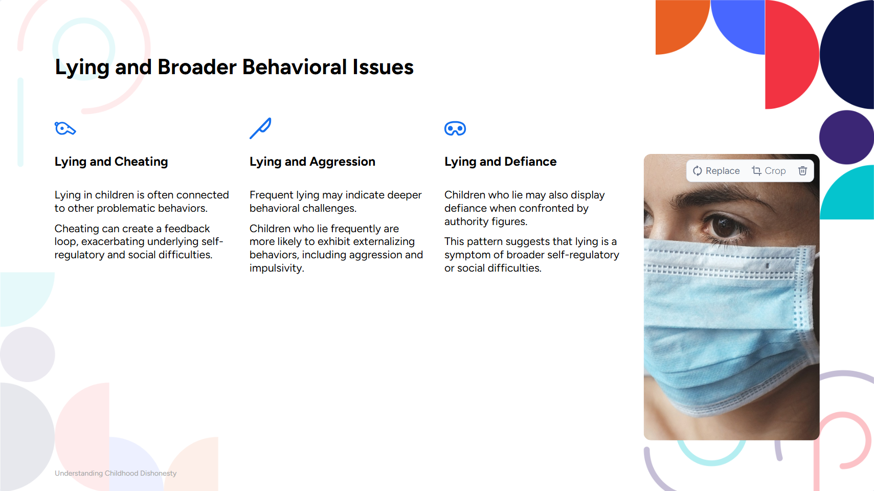




Slide 103
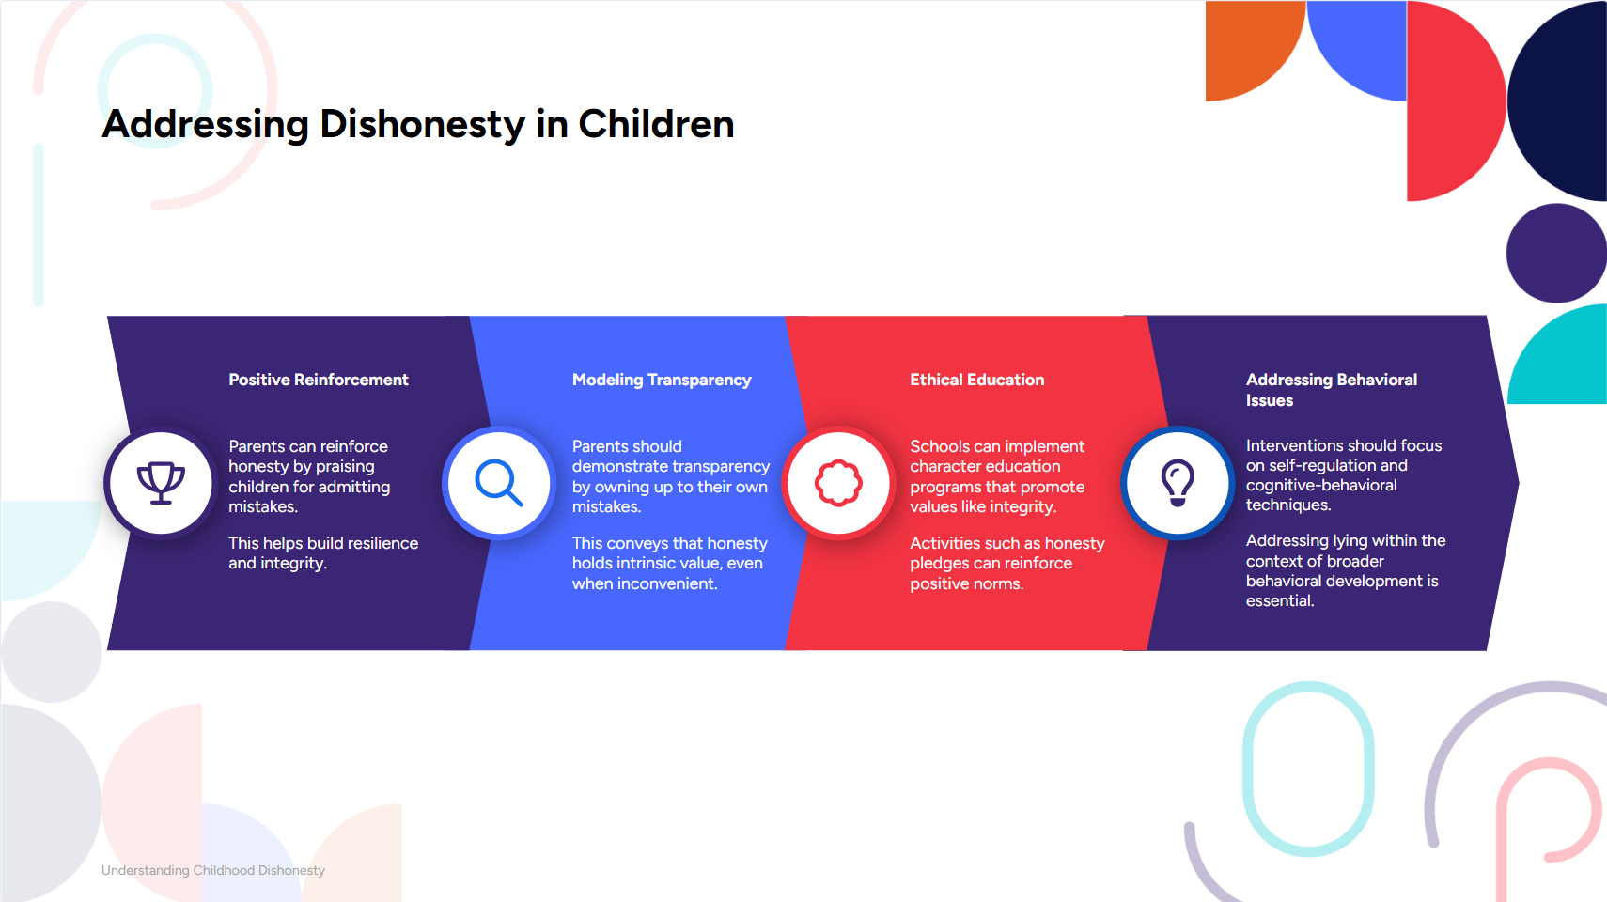



Slide 104


Fostering Honesty in Children
Cognitive Growth: Enables both deception and self-regulation.
Parental Influence: Honest modeling reinforces integrity.
Behavioral Links: Lying ties to aggression, requiring broader strategies.
Practical Steps:
Create integrity-focused environments.
Model honesty and celebrate truth-telling.
Interventions: Mindfulness & counseling for self-regulation.
Goal: Build a strong ethical foundation.

Slide 105





The Effects of Lying | Georgia Haukom | TEDxKids@ElCajon

